Slide 1

Red Dead Redemption
R.A.G.E ENGINE

Slide 2


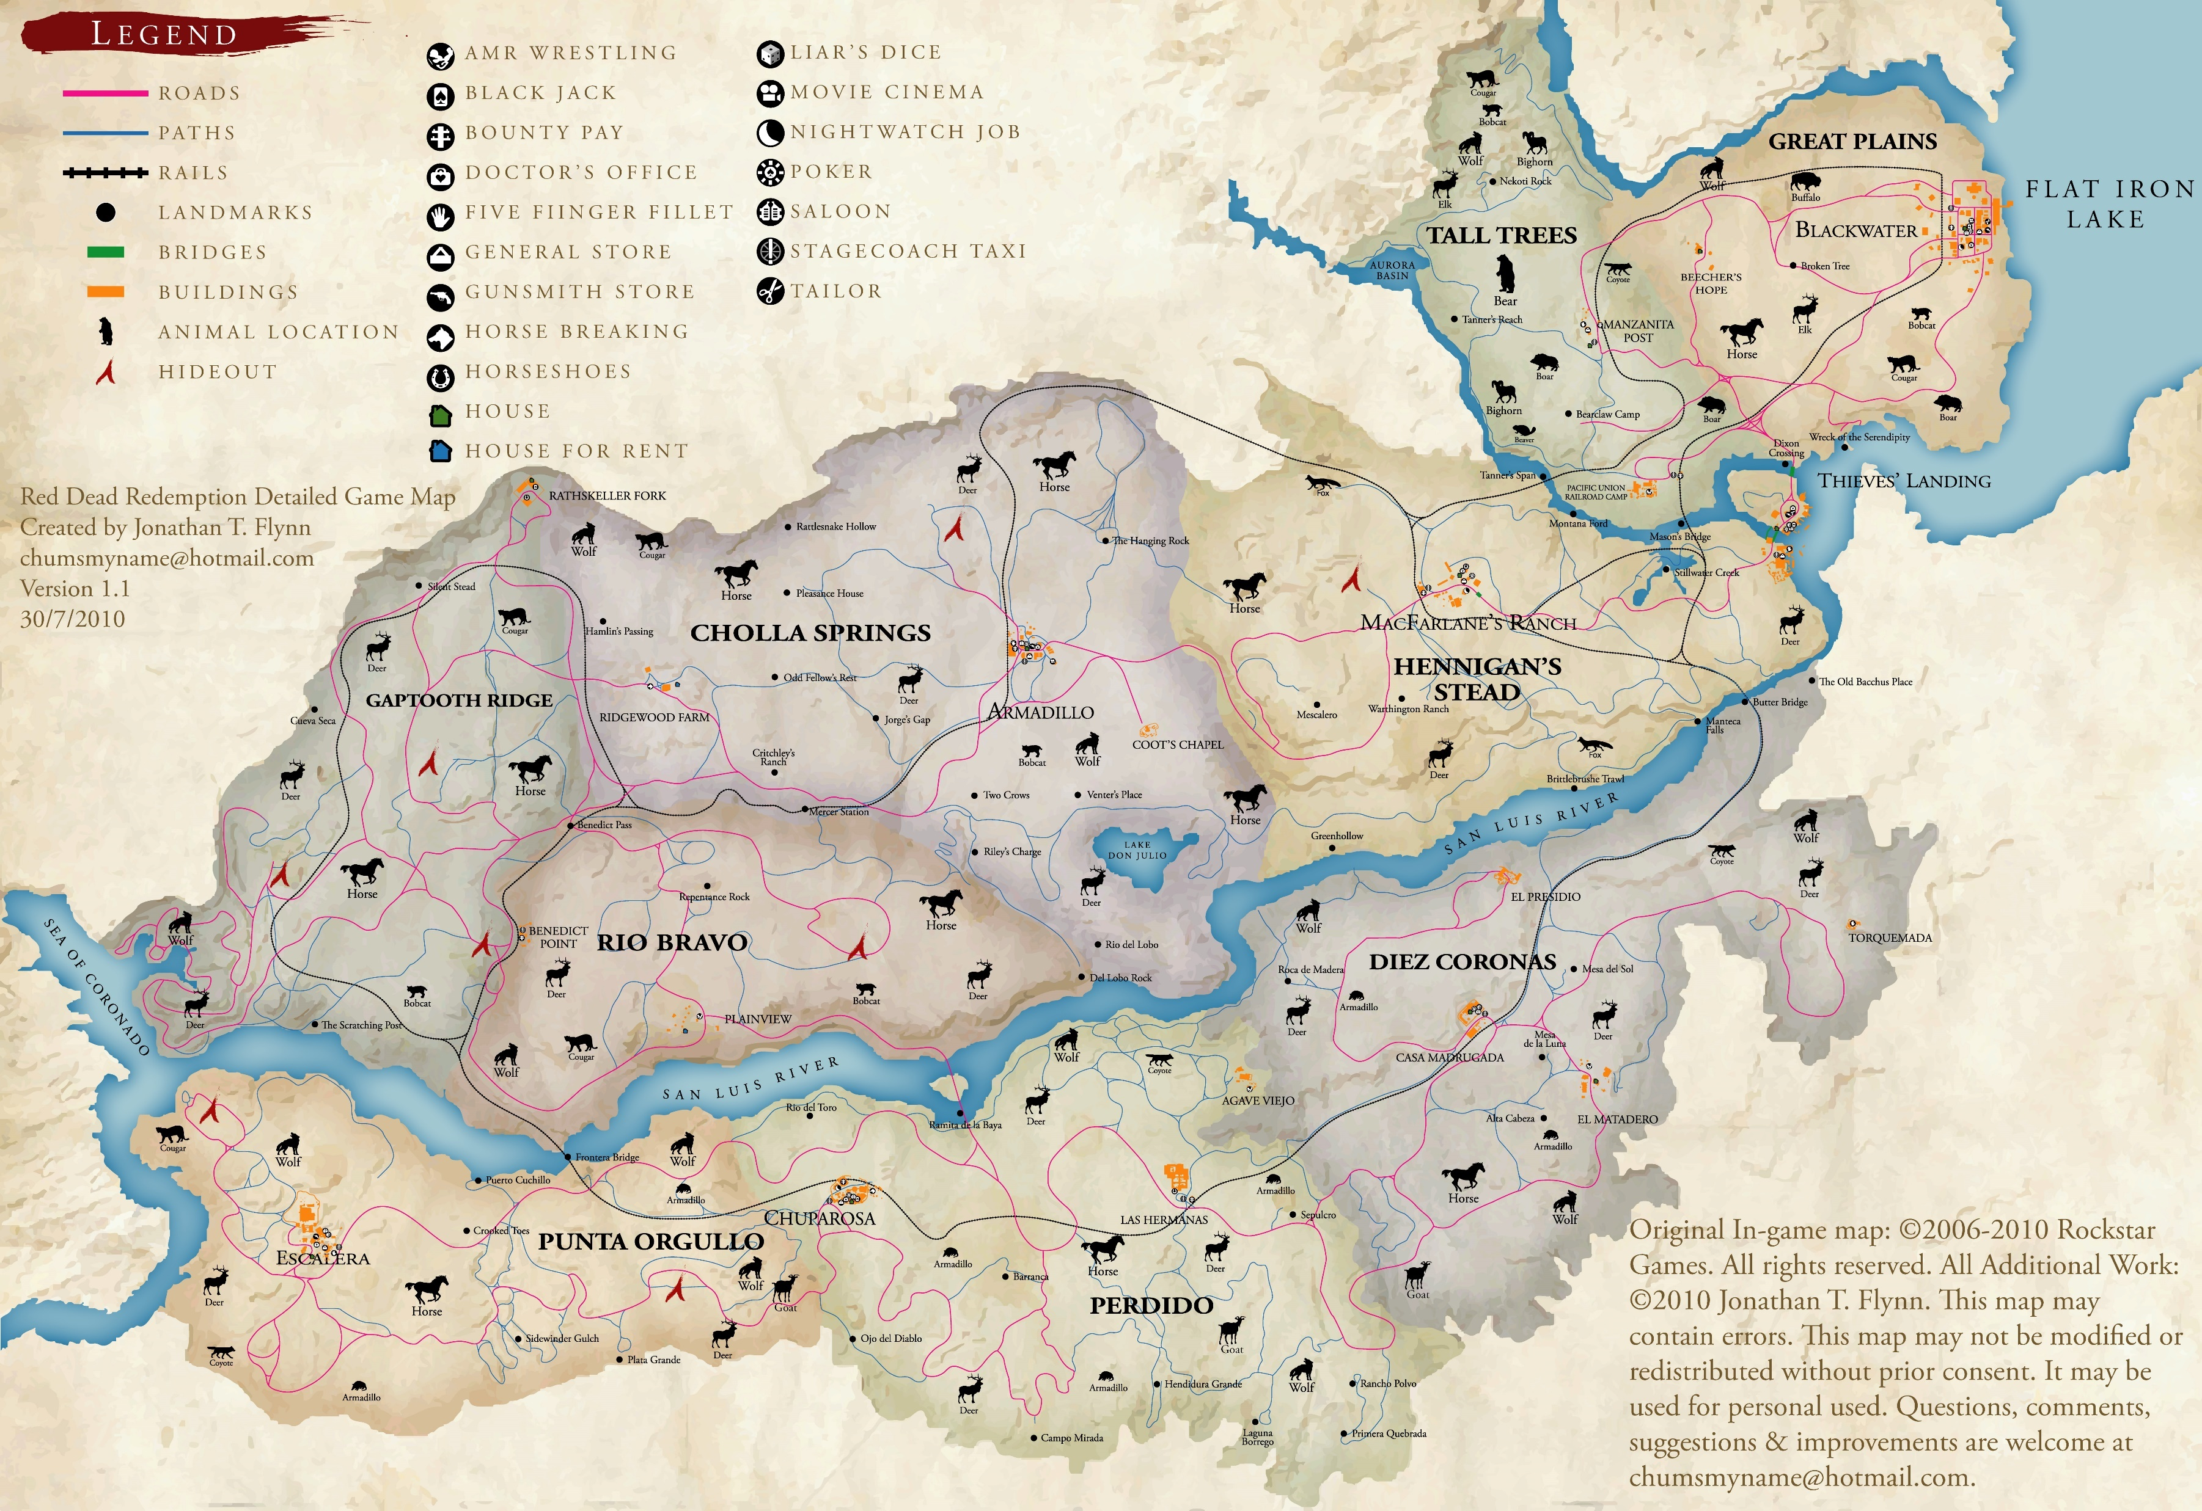
Red Dead Redemption

Slide 3

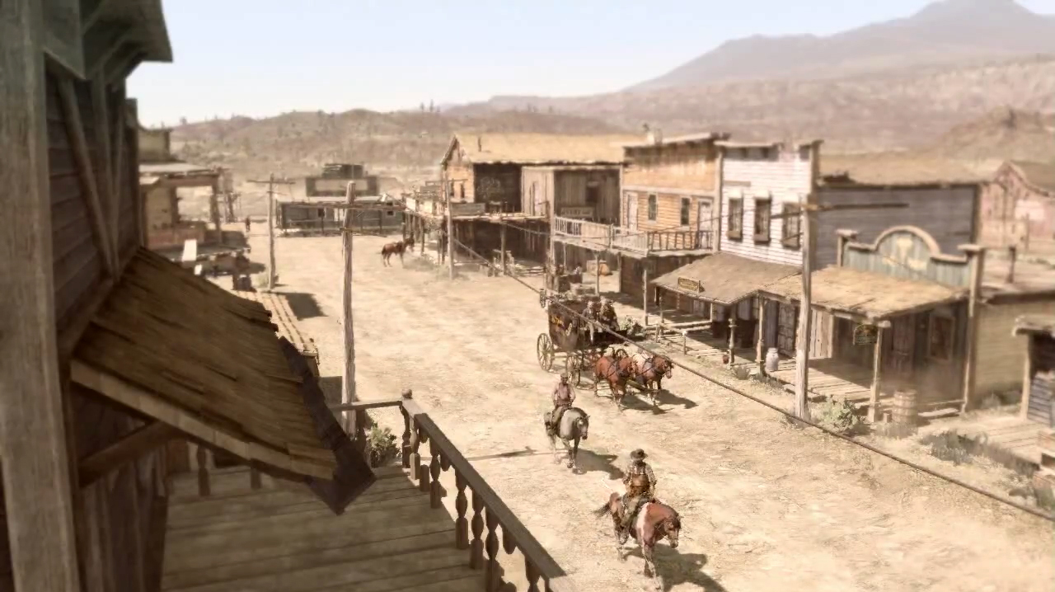
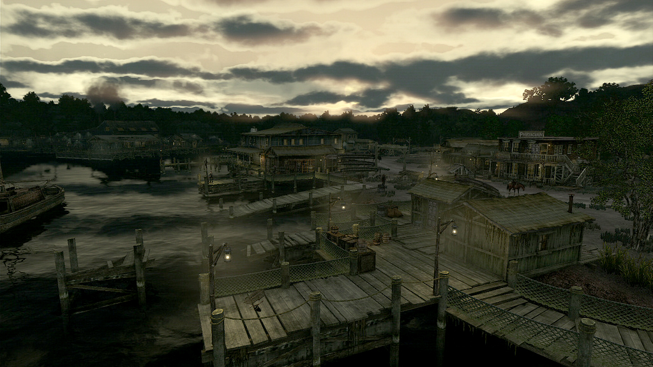
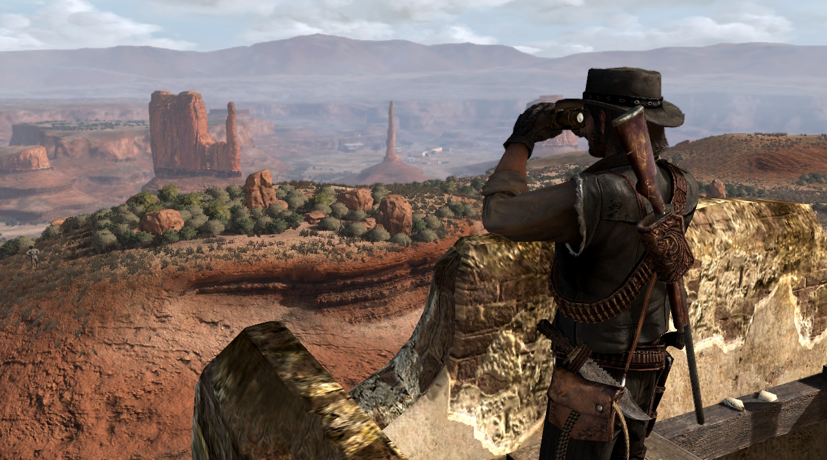
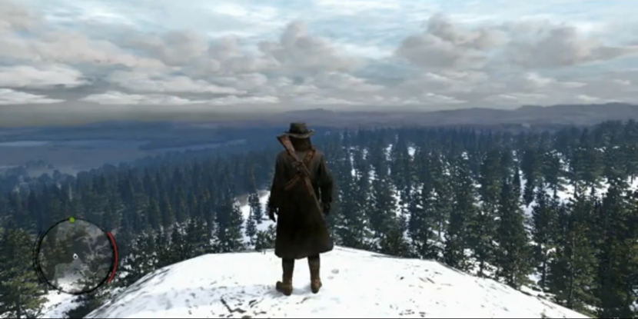
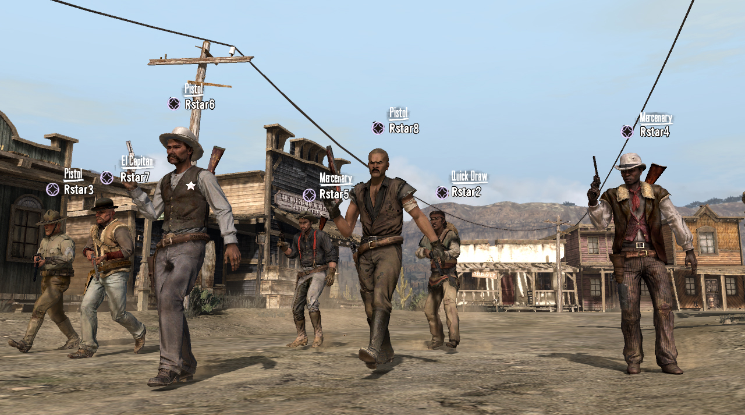
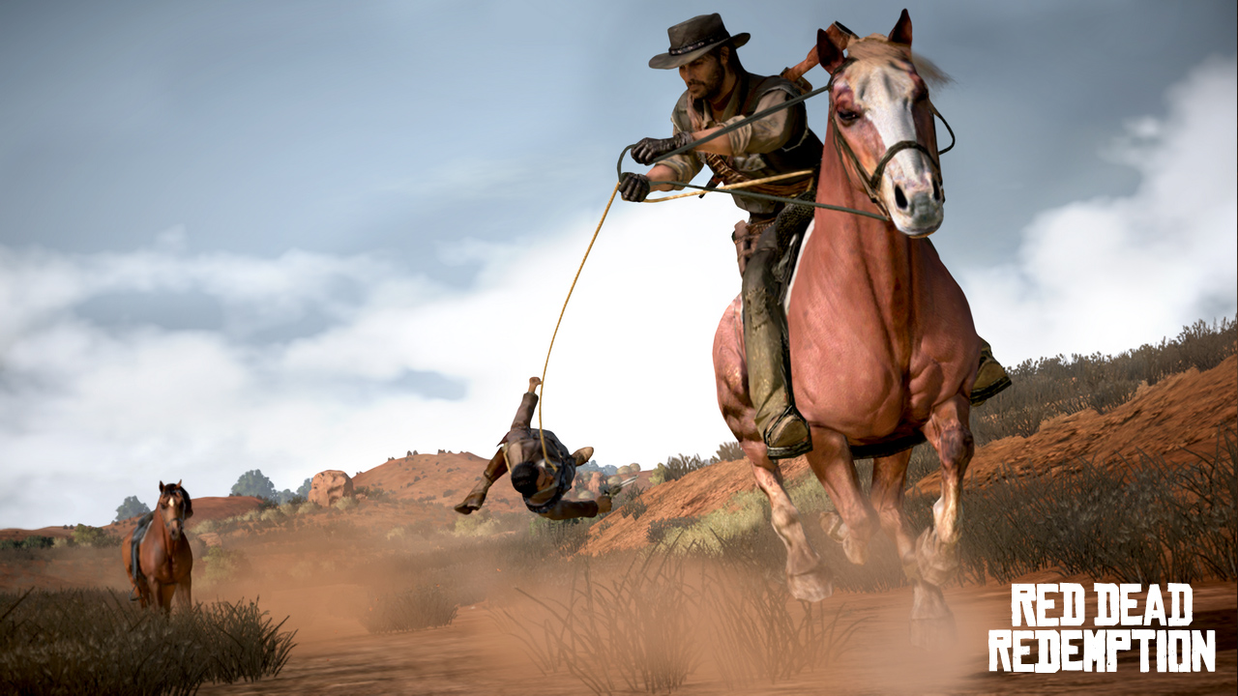
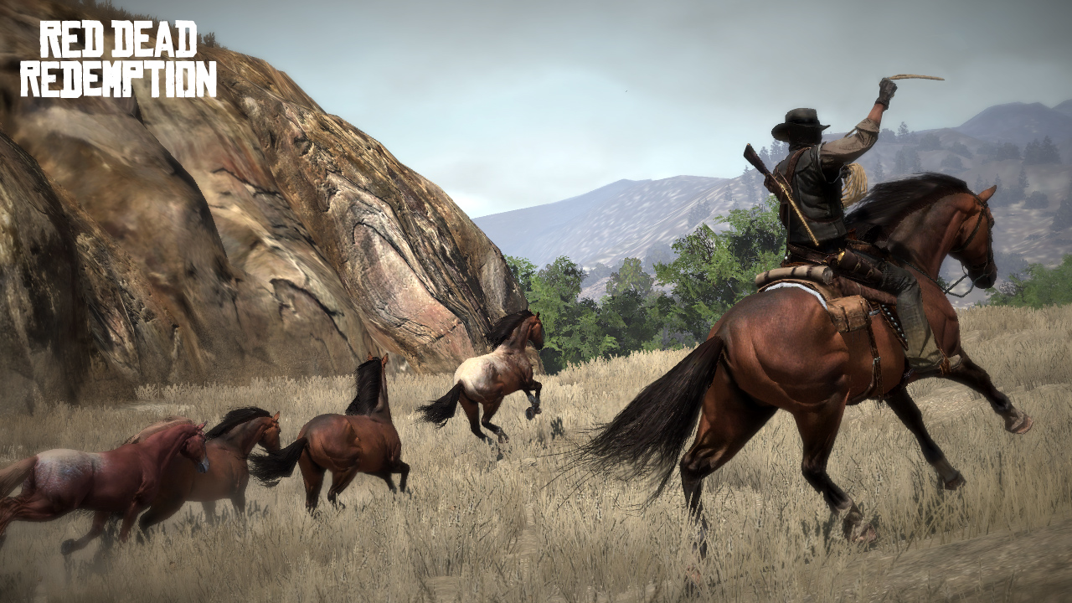
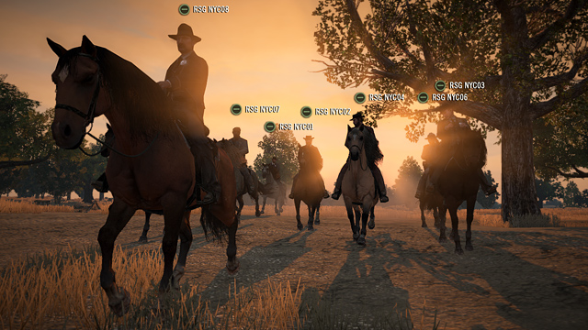

Slide 4




R.A.G.E Engine
-Multiplatform
-Initially evolved from the Angel Game Engine
-Never began as an engine, beginning simply as a few components – Rendering engine, Physics engine etc
-Integrated 3rd party softwares
“RAGE's strengths are many. Its ability to handle large streaming worlds, complex A.I. arrangements, weather effects, fast network code and a multitude of gameplay styles will be obvious to anyone who has played GTA IV.”

Slide 5

R.A.G.E and Euphoria

Slide 6



Slide 7

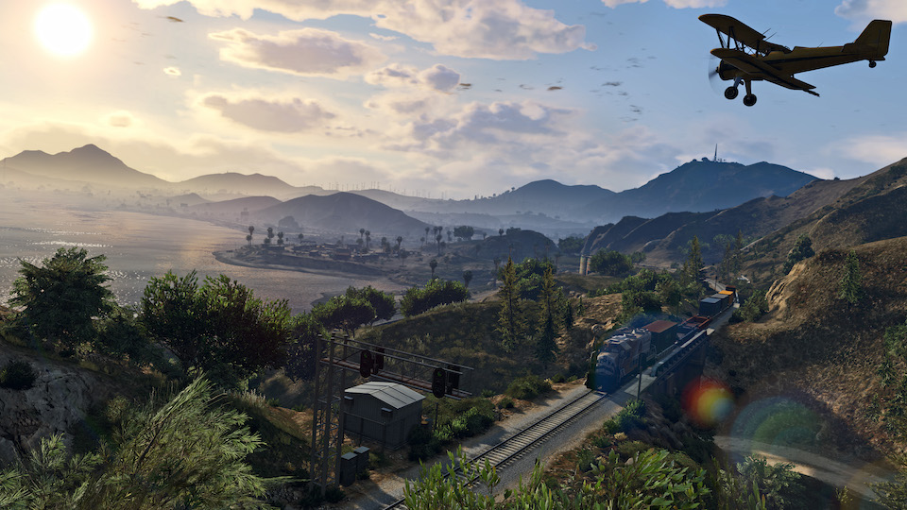
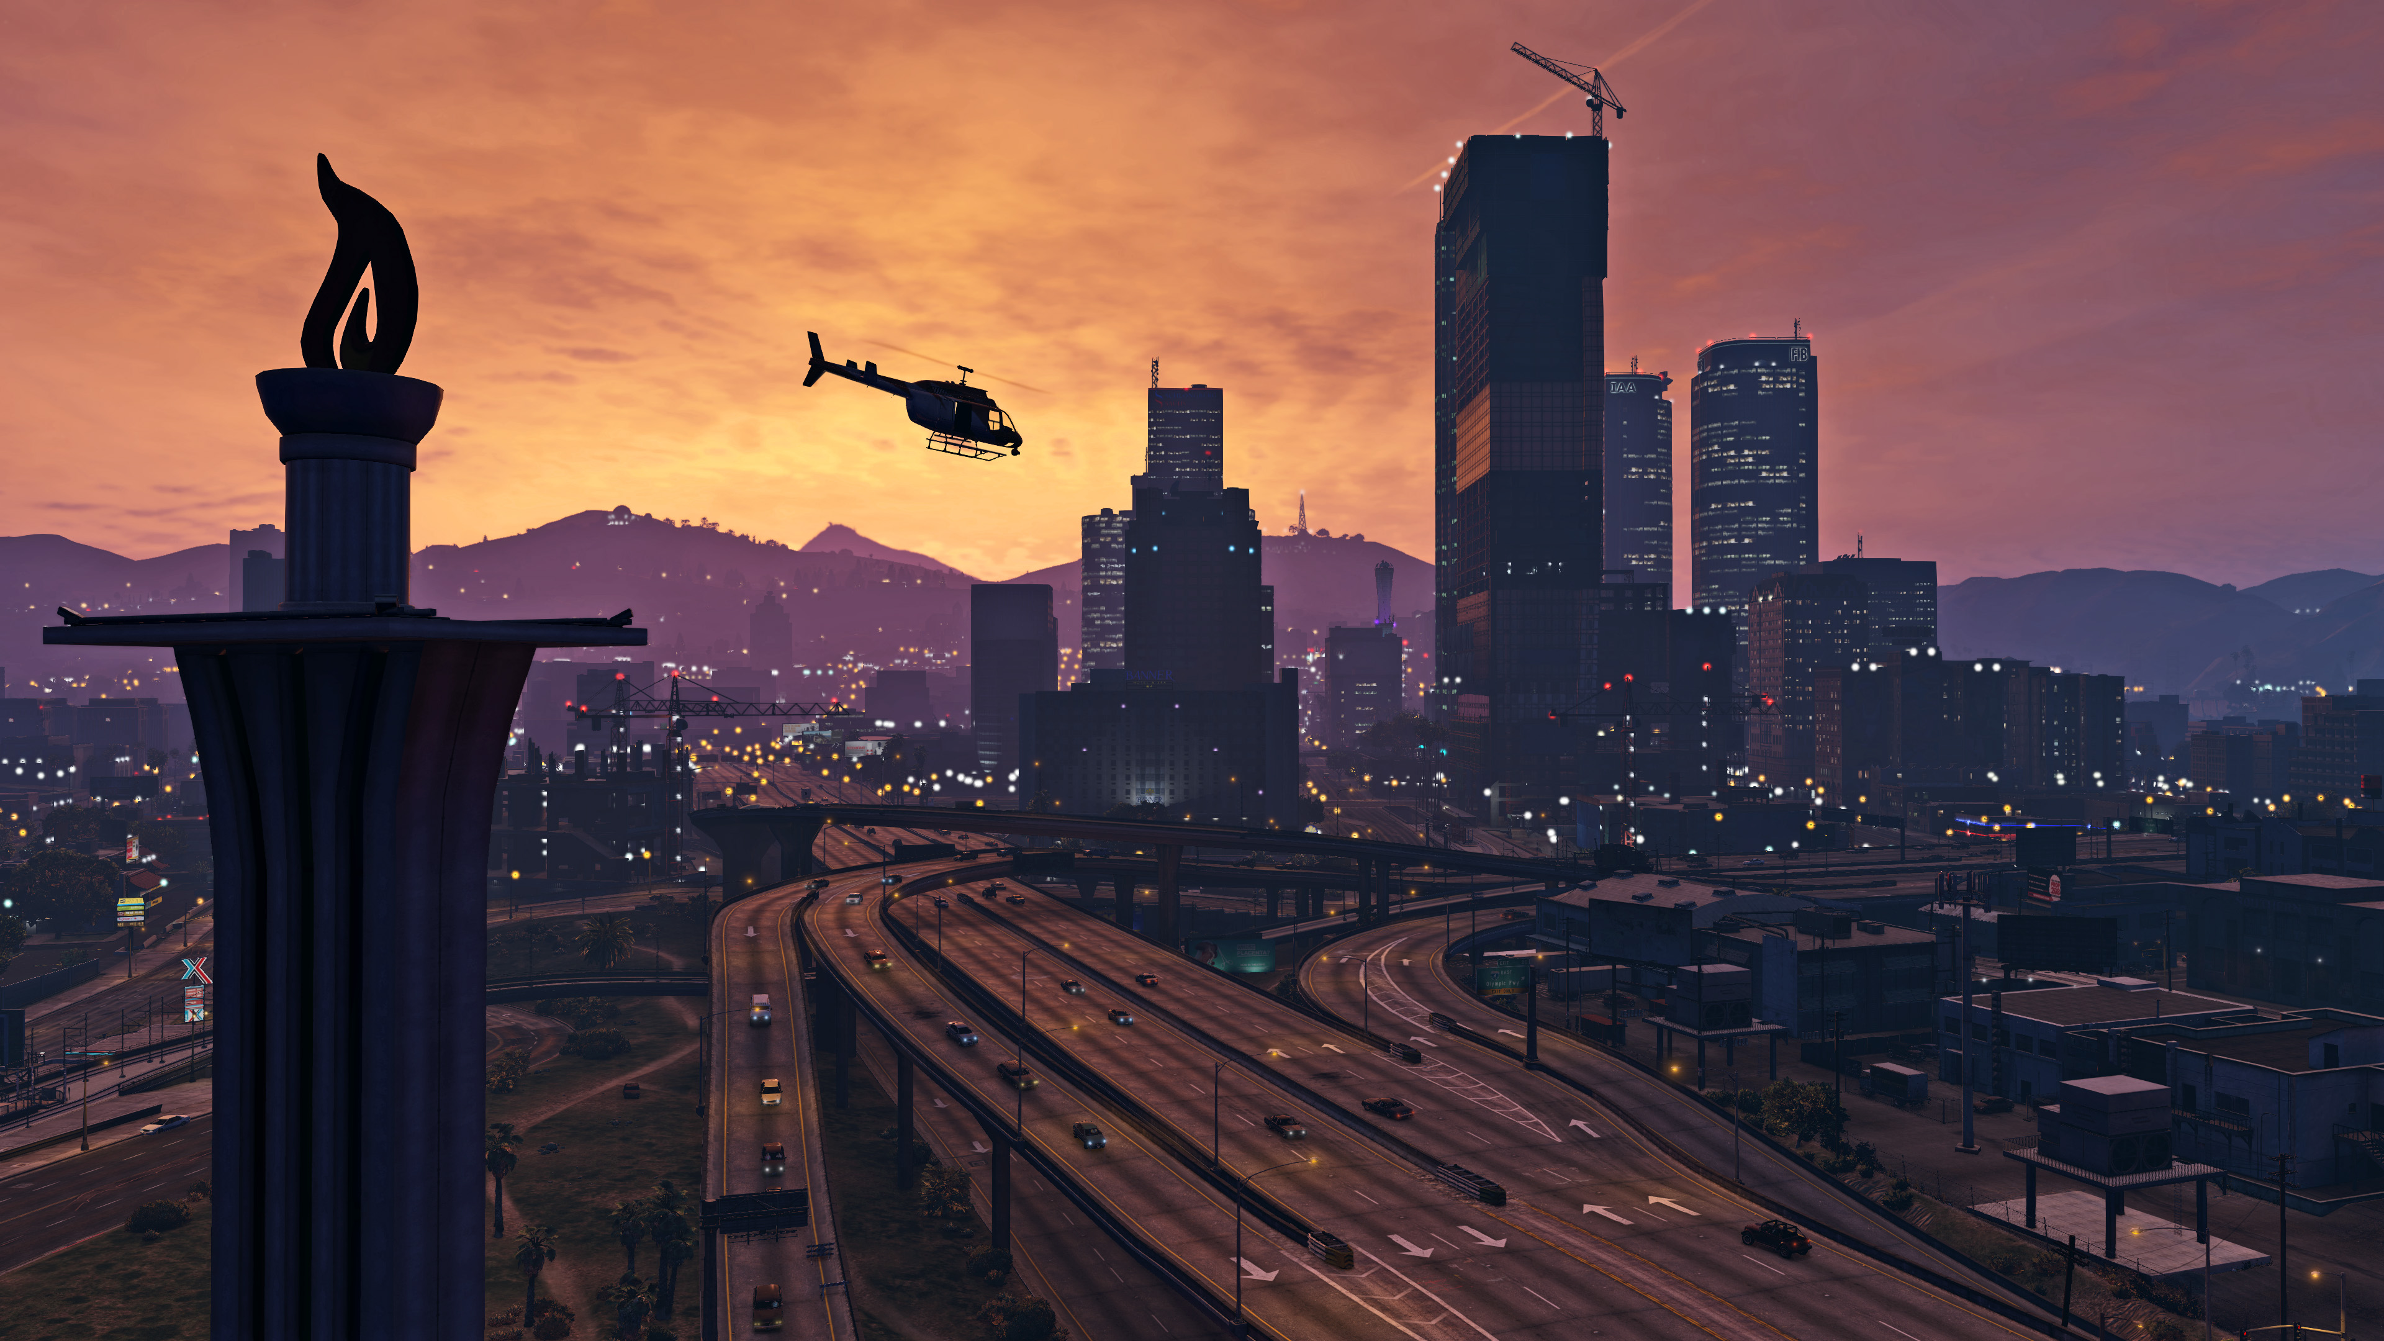

Slide 8

Thank you!
ANY QUESTIONS?
-Ross McRitchie

Slide 9
References
3rd Party Partnerships for Natural Motion
https://web.archive.org/web/20080517013929/http://naturalmotion.com/files/nm_rockstar_2007.pdf
New tech for Gta V, including the engines beginnings
http://www.techradar.com/news/gaming/the-tech-that-built-an-empire-how-rockstar-created-the-world-of-gta-5-1181281
Rage engine line up by IGN
http://uk.ign.com/articles/2009/07/15/the-10-best-game-engines-of-this-generation
Images from Google Images/Rockstar Advertisments
Rockstar advertisement videos from Youtube

